Slide 1

DAV-5400-1 Analytics Programming Final project Tianyu Sun

Slide 2




Introduction
Since the 1990s, developed countries have begun to cultivate a large number of data analysts. Until now, the demand for data analysts has continued to grow, and there is still an expansion.
I want to know more about the characteristics of the industry.

Slide 3
Research Questions
Data analysis practitioners advocate the programming language.
Data analysis practitioners advocate tools
Data analysis practitioners' occupational classification.
Data analysis practitioners' age structure and educational background.
Data analysis is an algorithm of interest to practitioners.

Slide 4
Data to be used
Data Sources:
https://www.kaggle.com/kaggle/kaggle-survey-2017 Download the data from the kaggle website and save it as a csv file.
2017 Kaggle ML & DS Survey
A big picture view of the state of data science and machine learning.
https://api.github.com Collect data on github using web api

Slide 5
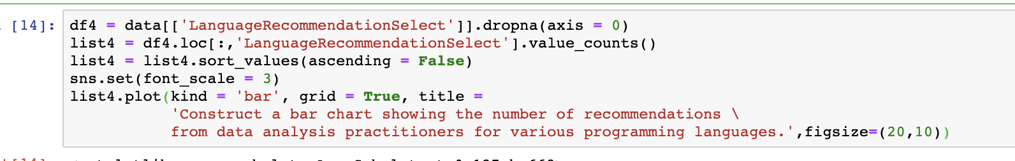
Q1: Construct a bar chart showing the number of recommendations from data analysis practitioners for various programming languages.

Slide 6
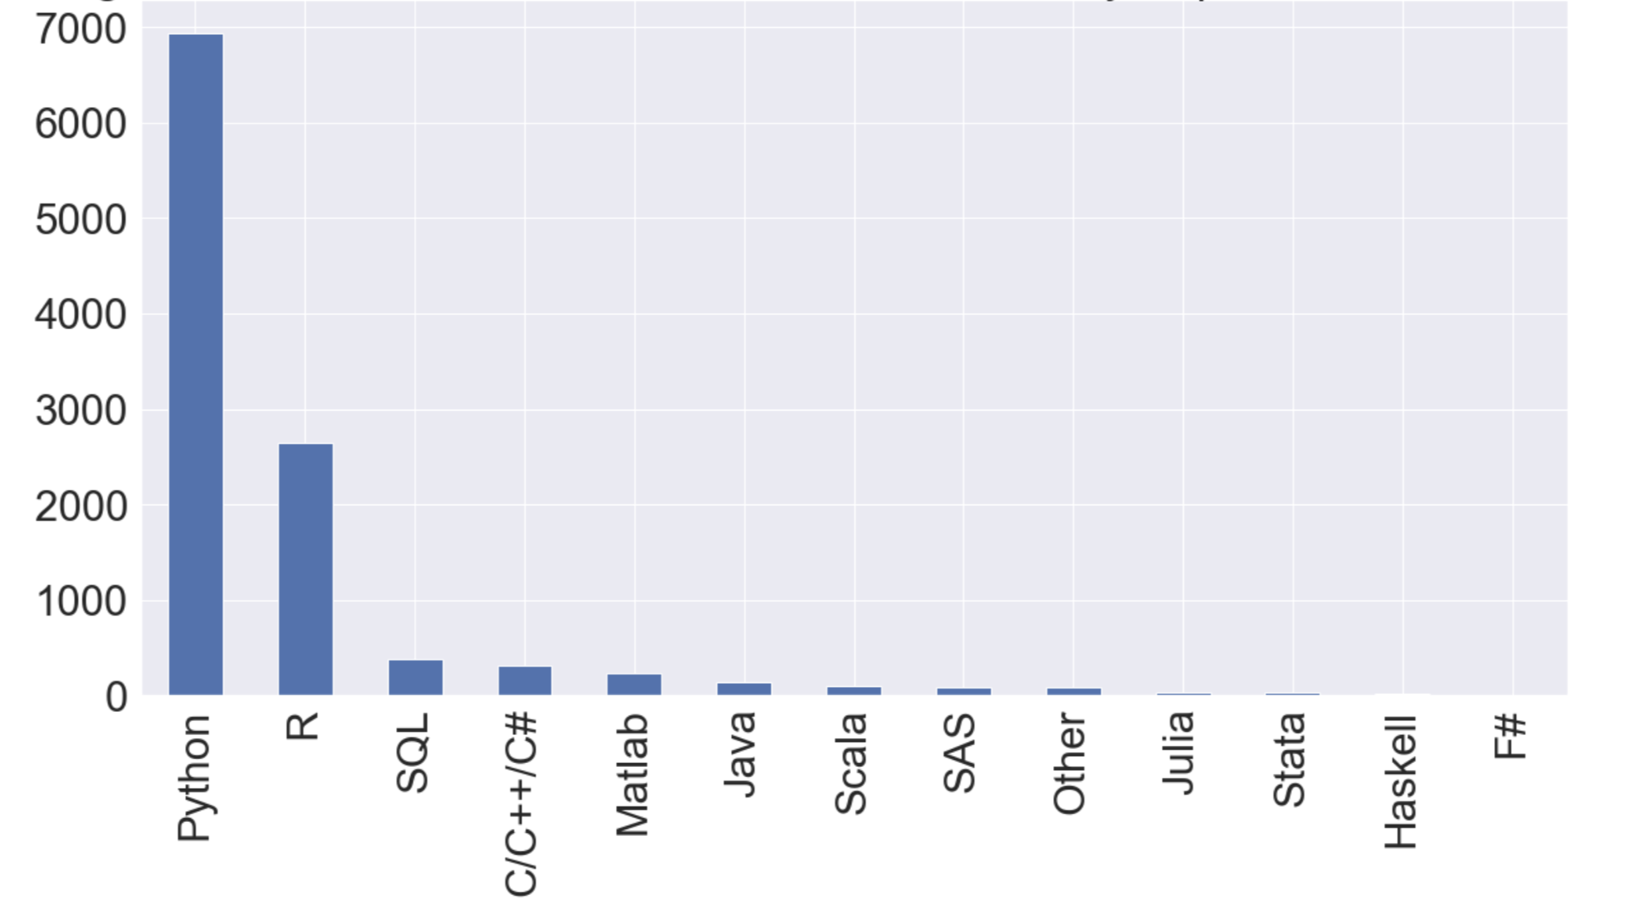

Slide 7
Conclusion
Python is the programming language of choice for most data analysis practitioners

Slide 8
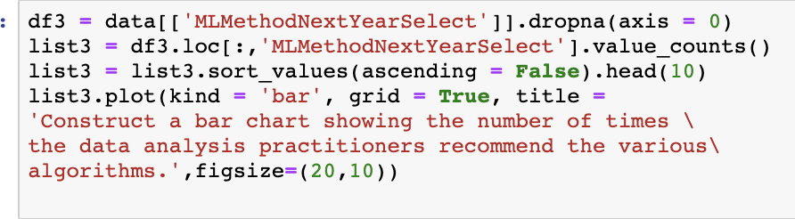
Q2: Construct a bar chart showing the number of times the data analysis practitioners recommend the various algorithms.

Slide 9
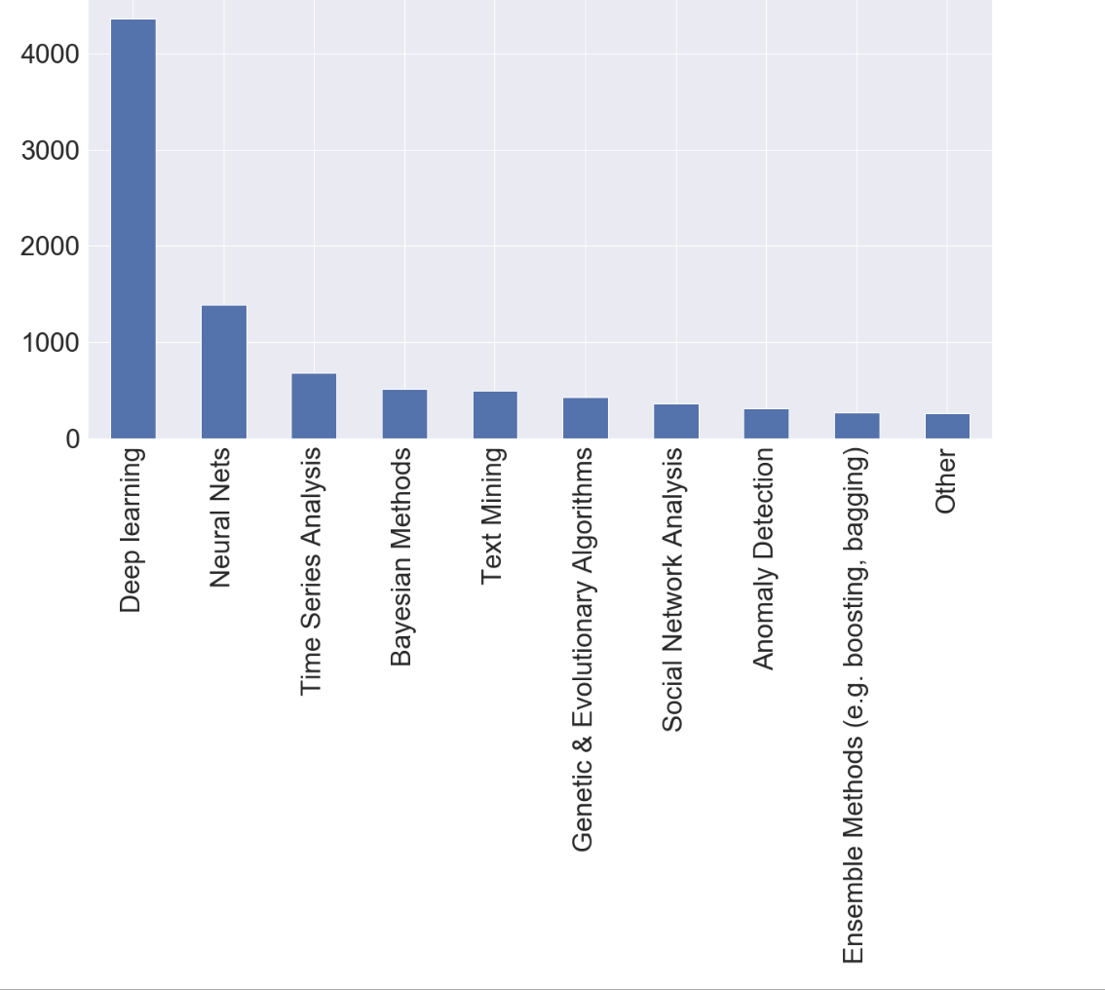

Slide 10
Conclusion
Deep Learning is the algorithm recommended by most people. Artificial intelligence is a hot topic in the data analysis industry.

Slide 11
challenge
Font size
When I wanted to do ppt, I found that the text under the chart was small, then I checked the information on the Internet, and found that as long as I typed sns.set(font_scale = 2)
, the font can become larger. The larger the number you enter, the larger the font.

Slide 12
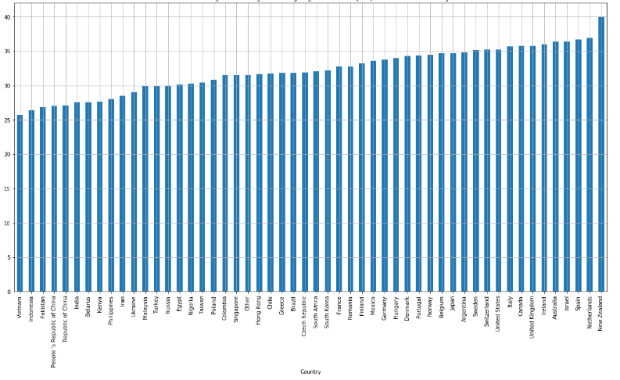

Slide 13
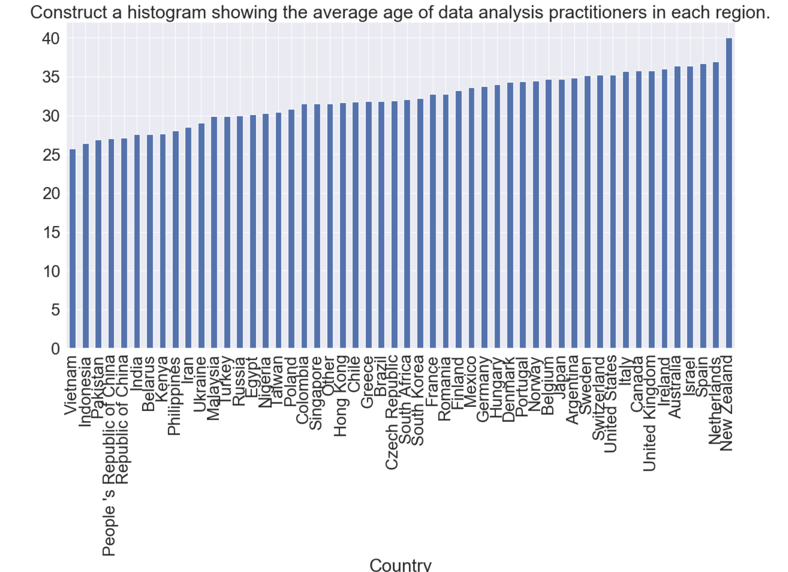

Slide 14
It is impossible to analyze all these factors. I will select some and then process the data appropriately.
https://github.com/Tsun1/DAV-540/blob/master/final%20project.ipynb
200 columns

Slide 15
Thank you

